Slide 1
Image Classification using Reinforcement Learning
Suvarthi Sarkar
University of Calcutta
Exam Roll Number: 97/CSM/19/1014
Exam Roll Number: 02
Registration Number: A01-1112-0898-14

Slide 2
Problem Definition
Agent
Class 1
Input Image
Class 2
Class n

Slide 3

Reinforcement Learning

Slide 4
Why?
In supervised Learning, the model adjust the parameters to get right the prediction for the training data, and the goal is to generalize to unseen data.
So, accuracy of the model is dependent on the trained data, giving rise to inconsistent accuracy.

Slide 5
Types of Reinforcement Learning
Model Free Reinforcement Learning
Deep Q-Learning
Proximal Policy Optimization
Model Based Reinforcement Learning

Slide 6
Dataset
MNIST-consisting of a training set of 60,000 examples and a test set of 10,000 examples. Size-28*28
Fashion-MNIST-consisting of a training set of 60,000 examples and a test set of 10,000 examples. Size-28*28
CIFAR 10-consists of 60000 32x32 colour images in 10 classes, with 6000 images per class. There are 50000 training images and 10000 test images.

Slide 7
Deep Q- Learning

Slide 8
Basic Terminology
Q(S_{t}, A) -> Q(S_{t+1})

Slide 9
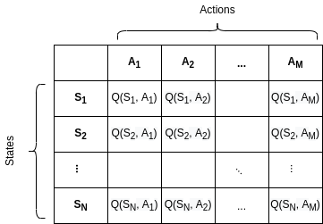
Q- Table

Slide 10
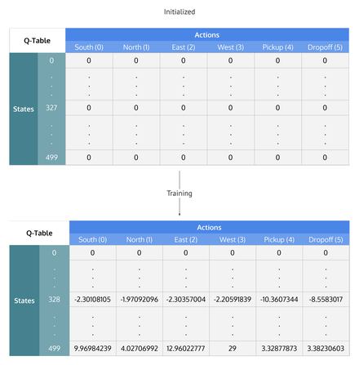
Q-Table

Slide 11
Two approaches
Exploring
Exploiting

Slide 12
Reward Function
Reward function for a certain class of image(C_{i}) =
1- |image of class C_{i} |/|total number of image for training|

Slide 13
Example of Reward Function
Image of type Object 1 = 400
Image of type Object 2 = 600
Reward for correctly guessing Object 1 = 1-2/5 = 3/5
Reward for wrongly guessing Object 1 = -3/5
Reward for correctly guessing Object 2 = 1-3/5 = 2/5
Reward for wrongly guessing Object 2 = -2/5

Slide 14
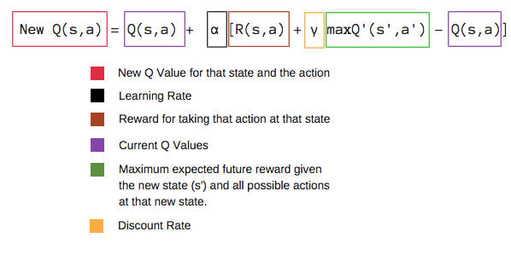
Bellman Equation

Slide 15
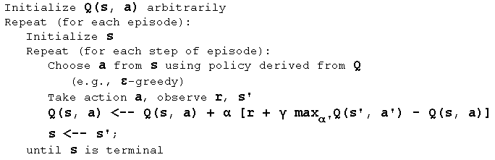
Algorithm Q-Learning

Slide 16
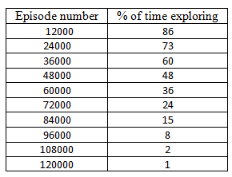
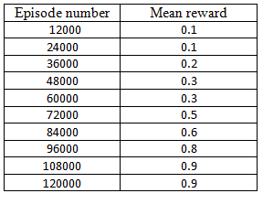
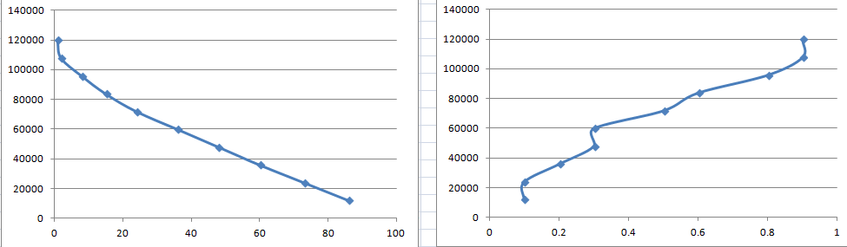
Training MNIST (32 Layers)
EPISODE
% of time exploring
Mean Reward

Slide 17
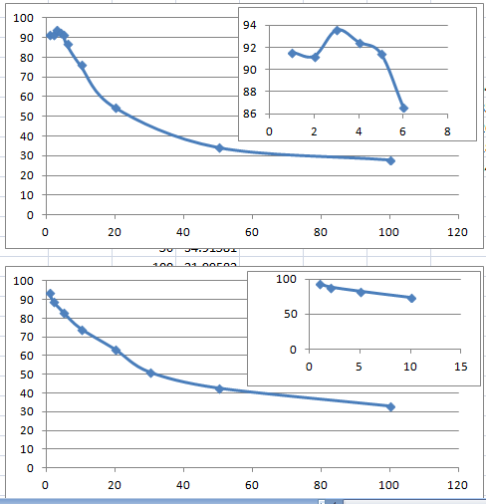
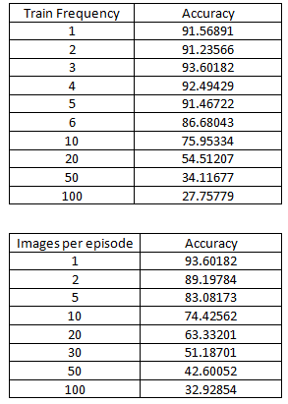
Testing MNIST
ACCURACY
Training Frequency
Images per episode

Slide 18
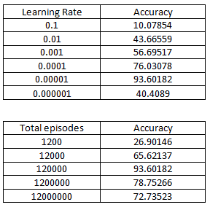
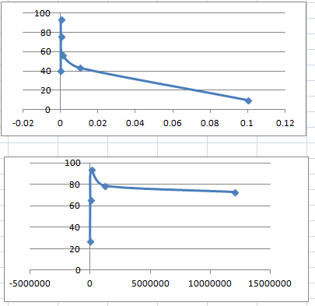
Testing MNIST
ACCURACY
Learning Rate
Total Episodes

Slide 19
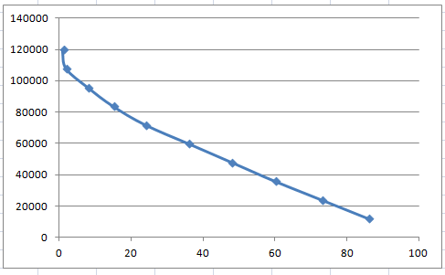
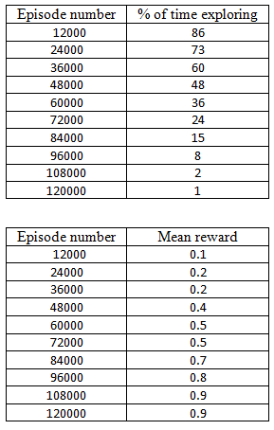
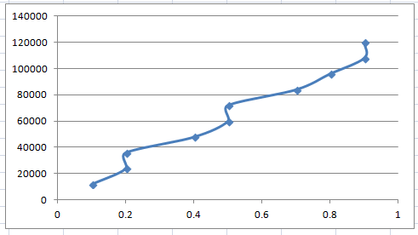
Training MNIST (64 Layers)
EPISODE
% of time exploring
Mean Reward

Slide 20
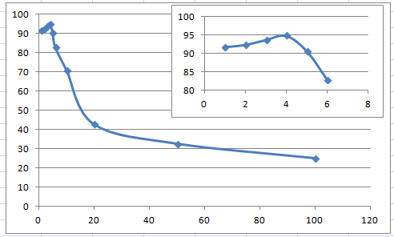
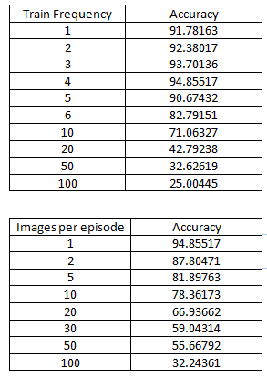
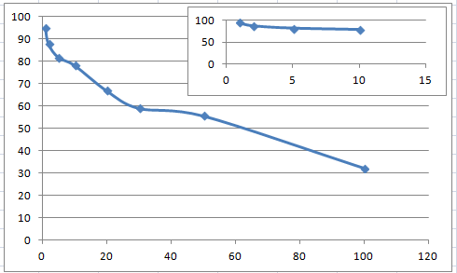
Testing MNIST
ACCURACY
Training Frequency
Images per episode

Slide 21
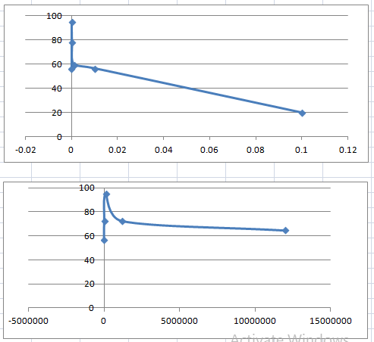
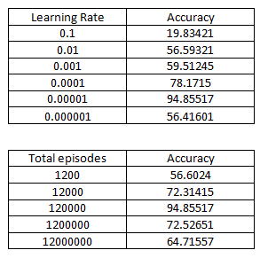
Testing MNIST
ACCURACY
Learning Rate
Total Episodes

Slide 22
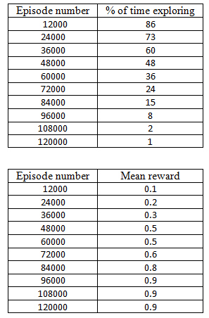
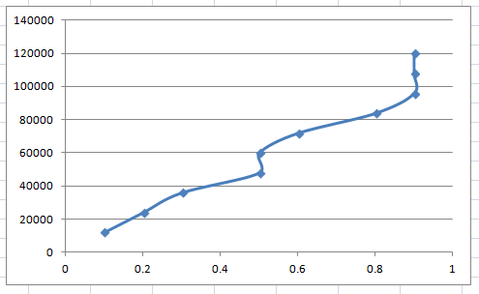
Training MNIST (128 Layers)
EPISODE
% of time exploring
Mean Reward

Slide 23
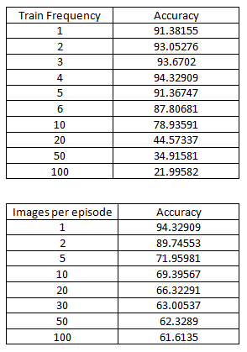
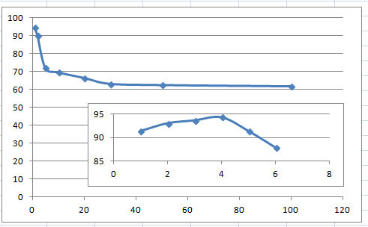
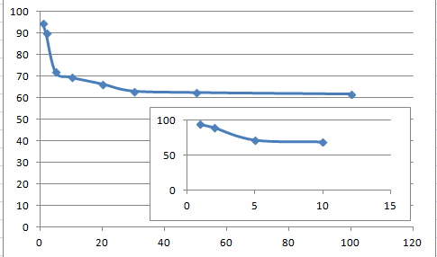
Testing MNIST
ACCURACY
Training Frequency
Images per episode

Slide 24
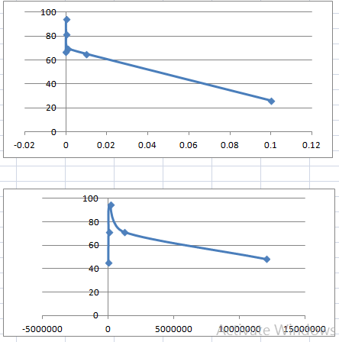
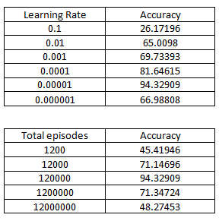
Testing MNIST
ACCURACY
Learning Rate
Total Episodes

Slide 25
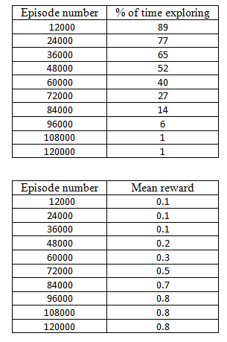
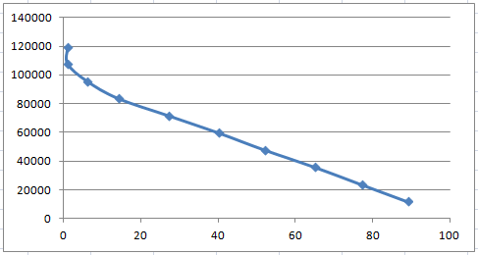
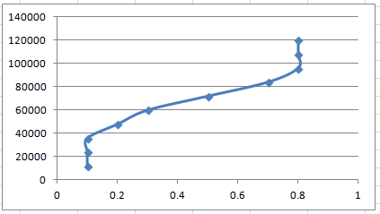
Training Fashion MNIST (32 Layers)
EPISODE
% of time exploring
Mean Reward

Slide 26
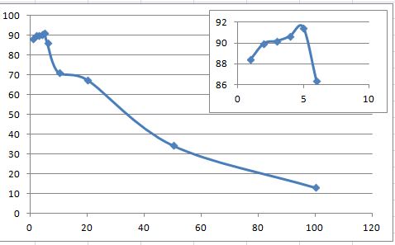
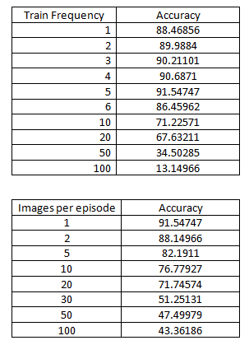
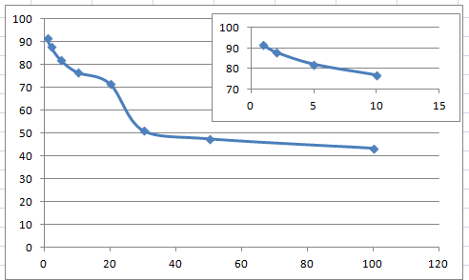
Testing Fashion MNIST
ACCURACY
Training Frequency
Images per episode

Slide 27
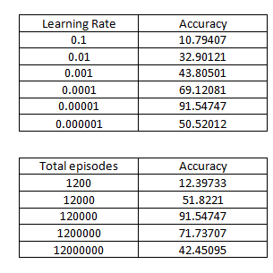
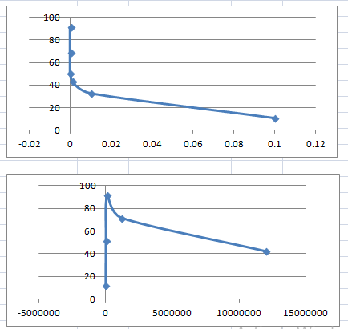
Testing Fashion MNIST
ACCURACY
Learning Rate
Total Episodes

Slide 28
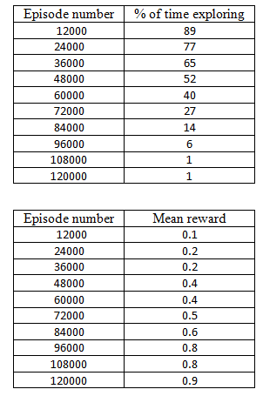
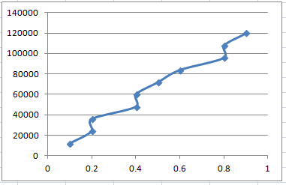
Training Fashion MNIST (64 Layers)
EPISODE
% of time exploring
Mean Reward

Slide 29
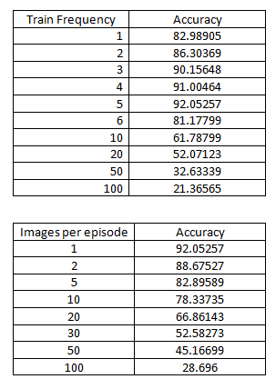
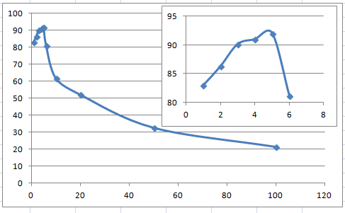
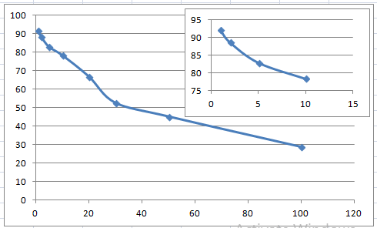
Testing Fashion MNIST
ACCURACY
Training Frequency
Images per episode

Slide 30
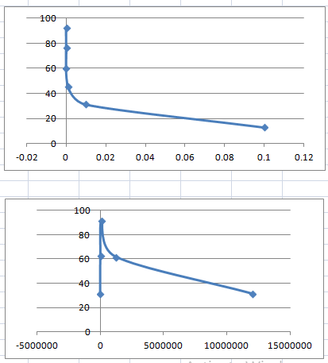
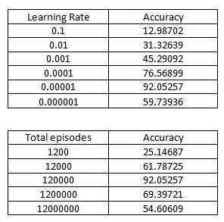
Testing Fashion MNIST
ACCURACY
Learning Rate
Total Episodes

Slide 31
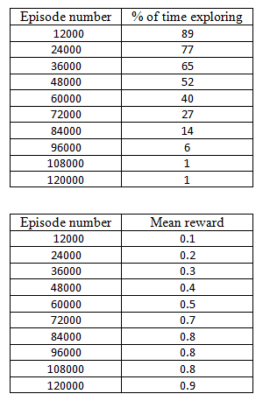
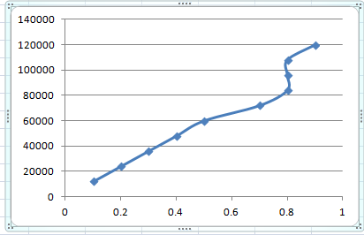
Training Fashion MNIST (128 Layers)
EPISODE
% of time exploring
Mean Reward

Slide 32
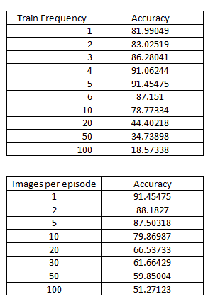
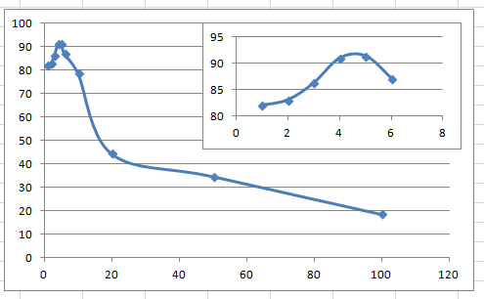
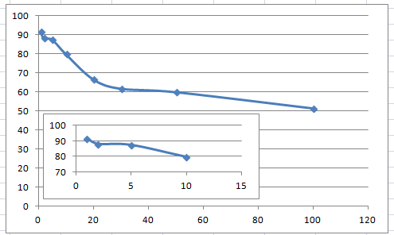
Testing Fashion MNIST
ACCURACY
Training Frequency
Images per episode

Slide 33
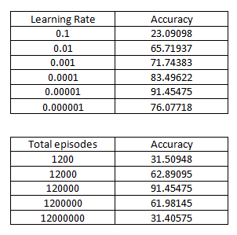
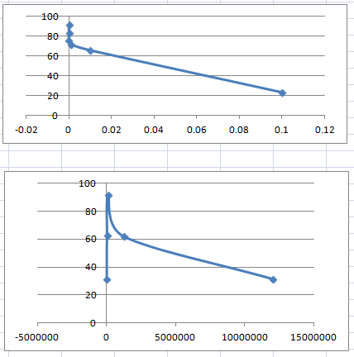
Testing Fashion MNIST
ACCURACY
Learning Rate
Total Episodes

Slide 34
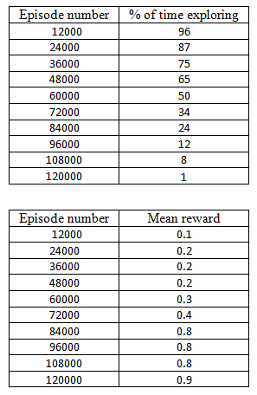
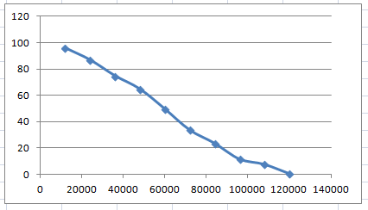

Training CIFAR 10 (32 Layers)
EPISODE
% of time exploring
Mean Reward

Slide 35



Testing CIFAR 10
ACCURACY
Training Frequency
Images per episode

Slide 36


Testing CIFAR 10
ACCURACY
Learning Rate
Total Episodes

Slide 37


Training CIFAR 10 (64 Layers)
EPISODE
% of time exploring
Mean Reward

Slide 38



Testing CIFAR 10
ACCURACY
Training Frequency
Images per episode

Slide 39


Testing CIFAR 10
ACCURACY
Learning Rate
Total Episodes

Slide 40


Training CIFAR 10 (128 Layers)
EPISODE
% of time exploring
Mean Reward

Slide 41



Testing CIFAR 10
ACCURACY
Training Frequency
Images per episode

Slide 42


Testing CIFAR 10
ACCURACY
Learning Rate
Total Episodes

Slide 43
Sparse Reward Setting/ Credit assignment problem
Agent is going to assume that since we lost that episode all of the actions that we took there must be bad actions and is going to reduce the likelihood of taking those actions in the future
Maybe the most part of that episode we were doing really well. The entire action was not bad, maybe the last bit.

Slide 44
Proximal Policy Optimization

Slide 45
Cumulative Reward
The mean cumulative episode reward over all agents. Should increase during a successful training session.

Slide 46

Objective function

Slide 47

Graph

Slide 48

Clipping

Slide 49

PPO MNIST

Slide 50

PPO Fashion MNIST

Slide 51

PPO CIFAR 10

Slide 52
Conclusion
Overall Achievement
Unique Aspect of our work
Future Scope

Slide 53
References
https://machinelearningmastery.com/object-recognition-with-deep-learning/
https://www.analyticsvidhya.com/blog/2019/08/3-techniques-extract-features-from-image-data-machine-learning-python/
Active Learning for Image Classification: A Deep Reinforcement Learning Approach
https://ieeexplore.ieee.org/abstract/document/8901911
Le Sun, Yihong Gong
Multi-Agent Image Classification via Reinforcement Learning
https://engineering.lehigh.edu/sites/engineering.lehigh.edu/files/_DEPARTMENTS/ise/pdf/tech-papers/19/19T_007.pdf
Hossein K. Mousavi , Mohammadreza Nazari , Martin Taka´cˇ , and Nader Motee, Lehigh University
Outline Objects using Deep Reinforcement Learning
https://arxiv.org/pdf/1804.04603.pdf
Zhenxin Wang, Sayan Sarcar, Kochi University of Technology
Selective Search for Object Recognition
https://ivi.fnwi.uva.nl/isis/publications/2013/UijlingsIJCV2013/UijlingsIJCV2013.pdf
J.R.R. Uijlings, K.E.A. van de Sande, T. Gevers , and A.W.M. Smeulders, University of Trento,2012, submitted to IJCV

